Slide 1
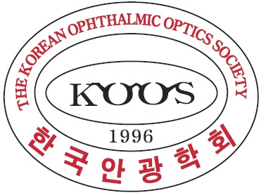

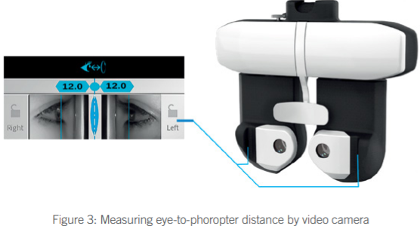
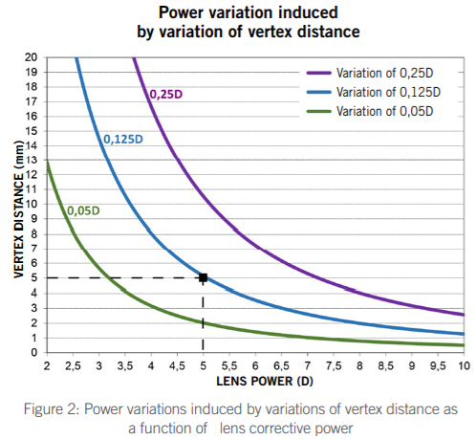
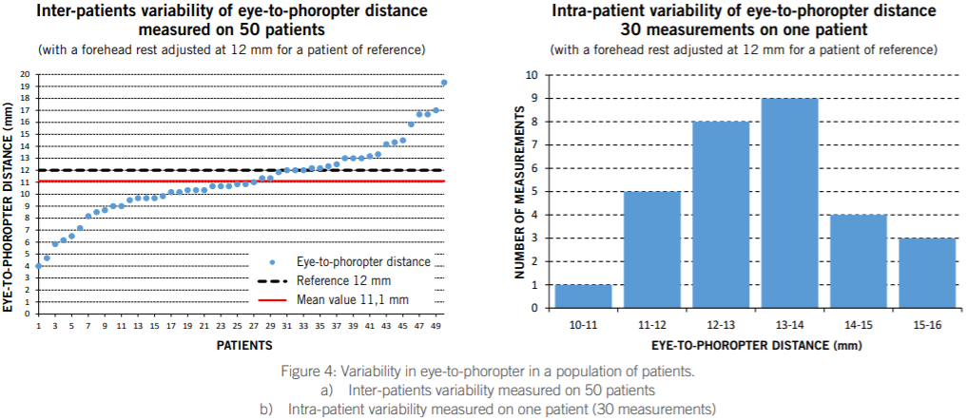
REFRACTION:
VERTEX DISTANCE MATTERS!
Mathilde Sebag¹ ∙ Dominique Meslin² ∙
¹Research Manager Research & Development Department Instruments Division Essilor International ,
²Refraction Solutions Director Instruments Division Essilor International
(Edited by Education & Professional Services team in Esssilor Korea)
INTRODUCTION
RESULTS
The power of an optical correction for ametropia depends on the distance between the optical corrective system and the eye – this is one of the laws of physiological optics! Since the principle of optical correction is based on making the image focal point of the lens and the far point of the eye coincide, it is essential to adjust the system’s focal distance – in other words, to modify its power – whenever the distance separating the corrective optical system from the eye is changed. For this reason, any value of an optical correction offered by a pair of eyeglasses depends on the vertex distance and every prescription should in theory be accompanied by the eye-to-phoropter distance it was established at. But in practice, this distance is rarely specified.
To illustrate our point, a series of measurements of eye-to-phoropter distances for patients in refraction examinations was made. This was performed using a phoropter equipped with a system of video cameras designed to determine accurate measurements* (Figure 3).
If the calculation is performed for all the correction powers and vertex distance variations, we can represent the effects using curves such as those in Figure 2.
They show the vertex distance variations that are necessary to induce the respective power variations of 0.25 D, 0.125 D or 0.05 D, depending on the corrective power.
We could, for example, determine from this that for a power of 5.00 D, a 5 mm (or +/- 2.5 mm) vertex distance induces a 0.125 D variation. We can then see the significant effects that vertex distance variations can have on optical correction.
METHODS
Eye-to-phoropter distance was measured in a sample of 50 patients selected at random. The phoropter position was adjusted for a reference patient at a distance of 12 mm with an adjustment to the forehead rest that was kept unchanged for the measurements performed on the remainder of the subjects.
Each measurement was taken as follows: the subject was placed behind the phoropter head, their gaze directed in the primary position, and was asked to look at a chart screen located 5 m away.
The phoropter’s interpupillary distance was adjusted for each eye. Using video cameras located behind each of the phoropter’s half-heads, photos of each eye were taken laterally and appeared on the phoropter’s control panel. Virtual reticle could then be adjusted and positioned in correspondence with the apex of each cornea.
The adjustments were first made binocularly, and then if a difference was found between the left and right eyes, they were made monocularly.
The system then indicated with great precision the value of the eye-to-phoropter distance in 0.5 mm increments. This measurement could be recorded. For each patient, the measurement was taken three times, the patients being asked to move back from the phoropter and then to reposition themselves.
In addition, 30 measurements were repeated on a patient of reference, asking him to move his head back from the phoropter after each measurement and reposition himself for each new measurement.
The results of these measurements are presented in Figure 4.
On the one hand, they show that the eye-to-phoropter distance varied by 15.5 mm (from 4.0 mm for the smallest to 19.5 mm for the largest) with an average established at 11.1 mm with a standard deviation of +/- 3.11 mm – which is considerable. On the other hand, the measurements repeated on one patient show a range of variation of 5.0 mm with a standard deviation of +/- 1.31 mm, that is also significant. It is thus very clear that the distance between the eye and the phoropter is an eminently variable parameter and depends on the morphology of a patient’s head as well as how the patient is positioned behind the phoropter. They show that the often-neglected parameter of eye-to-phoropter distance must absolutely be included in the calculation of a correction if it is to be accurate.
CONCLUSIONS
REFERENCES
Thanks to improvements in refraction and measuring instruments, vertex distance is a parameter that can now be measured very accurately and thus be taken into account.
It is becoming a complementary parameter of
a prescription for proposing highly accurate lenses.**
All vision-care professionals now have the opportunity to offer their patients a more accurate correction and make them benefit from an even better vision.
[1] Longo A., Meslin D., Une nouvelle approche de la réfraction subjective, Cahiers d’Ophtalmologie, numéro 230, pp 59-63, (Sept 2019). A new approach to subjective refraction, Points de Vue, www.pointsdevue. com (May 2020)
[2] Barthélemy B., Thiébaut T. In Contactologie. 2e éd. Optique et Vision. pp 293-305, Lavoisier (2012).
[3] Gatinel D., Distance verre-œil, at www.gatinel.com/recherche-formation/optique-paraxiale-et-pointscardinaux/formule-de-vergence/, (mise à jour 2019).
[4] Opticians, The influence of back vertex distance in ocular refraction, at www.opticianonline.net/news/theinfluence-of-back-vertex-distance-in-ocular-refraction, (2005).
2021 한국안광학회 동계학술대회

