Slide 1


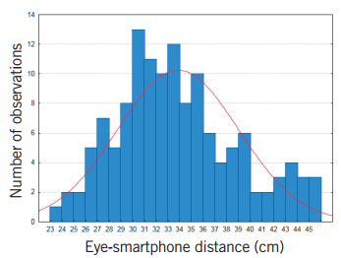
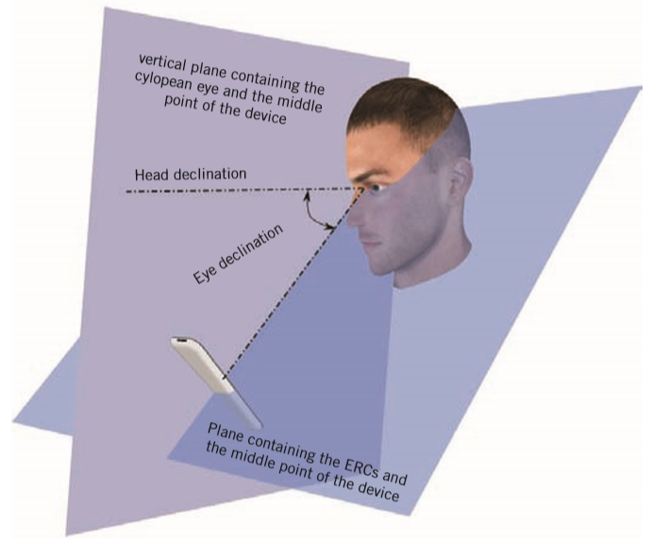
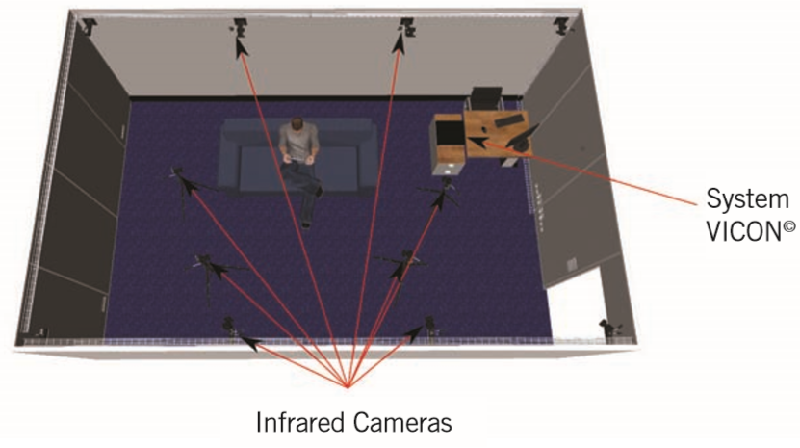
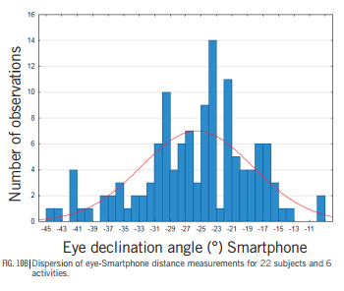
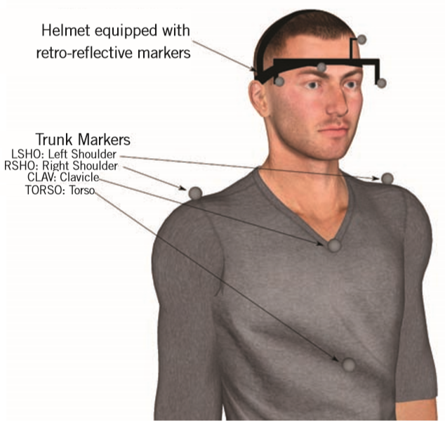
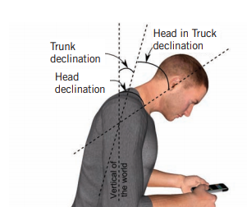
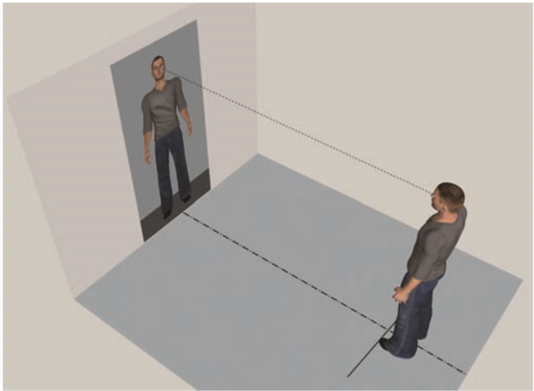
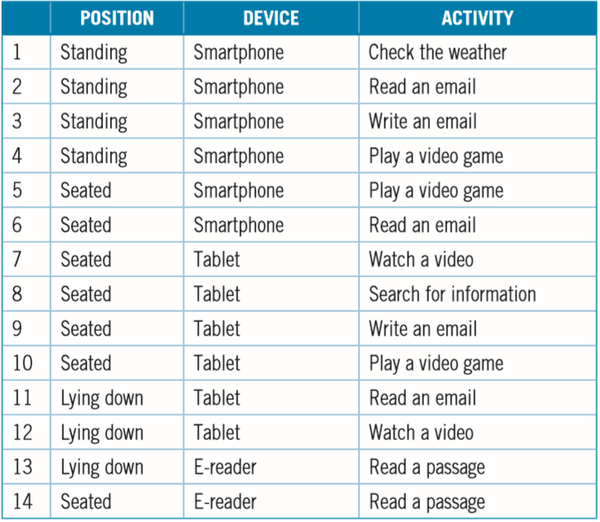
Impact of New Digital Technologies
On Posture
Damien Paillé¹
¹R&D Optics, Vision Sciences, Essilor International, Paris, France.
(Edited by Education & Professional Services team in Esssilor Korea)
INTRODUCTION
RESULTS
Electronic reading requires the reader to interact with his or her device. Furthermore, the vast majority of these devices are “mobile” or “handheld” devices and can be used in a wide range of everyday situations: while standing in public transport, sitting on a sofa, or lying in a bed. These new habits are revolutionizing the way we interact with traditional media and we can expect our postures to differ from those we adopt with paper media. Since ophthalmic lenses are traditionally designed to respond to the constraints of paper media, it is critically important to take an interest in these new behaviours. With this in mind, we undertook a study in 2013 to collect data on posture during the use of these new devices.
Eye-screen distance
The mean distance from the screen was 33.8 cm for the SCIENCE smartphone (SD 5.1 cm) Fig. 4; 38 cm for the e-book reader (SD 6.5 cm) and 39.7 cm for the tablet (SD 6 cm). Analysis of variance shows that there are significant differences between activities (F(14.294)=11.662 and p<0.05). Planned comparison analysis showed a significant difference (t(21)=7.358; MSE= 0.727; P=3.06E-7 < 0.05; d=1.56 ; CI95%[3.9; 6.8]) between small screens (4 inches for the smartphone) versus large screens (6 inches and 9.7 inches respectively for the e-book reader and the tablet). The smaller the screen, the closer the distance of use.
Eye declination
The mean eye declination angle was 25.6° for the smartphone (SD 7.2°) (Fig. 5); 20.2° for the e-book reader (SD 7.2°) and 20.3° for the tablet (SD 7.7°). Analysis of variance shows that there are significant differences between activities (F(14.280)=15.641 and p<0.05). Planned comparison analysis showed a significant difference (t(20)=5.872; MSE= 0.920; P=4.96E-7 < 0.05; d=1.58 ; CI95%[4.9; 8.5]) between standing and seated positions. But since the device most frequently used standing is the smartphone, we also found a significant difference between the smartphone and the two other devices (t(20)=6.942; MSE= 0.773; P=9.67E-7 < 0.05; d=1.51; CI95%[3.8; 6.9]). (Fig. 5a and Fig. 5b) By comparison, a study conducted internally on forty subjects showed that the mean eye declination angle for reading on paper is 18.7° (SD 6.1°) and for writing on paper is 13.8° (SD 8.8°). Eye declination in the use of recent digital devices is thus much more pronounced than is the case during use of paper media.
Other data
Head rotation relative to the trunk
We measured the angle in a horizontal plane between the head and the trunk. Analysis of variance shows that there are no significant differences between activities: F(14.266)=1.7223 and p=0.051. The mean angle between the head and the trunk is -0.3° (SD 5°) where a negative angle indicates head rotation to the left.
Since the mean angle is very small, we can conclude that when using digital devices, the head remains perpendicular to the trunk
(Fig. 6).
Roll angle of the head
We also measured the roll angle of the head. Analysis of variance shows that there are significant differences between activities: F(14.238)=2.4875 and p=0.026 < 0.05. However, planned comparison analysis shows no difference between devices or positions. The
mean roll angle for all activities combined is -2.9° (SD 3.6°)
where a negative angle indicates head rotation to the left. Since
the mean angle is very small, we can conclude that when using
digital devices, the head remains vertical.
Standard deviation of data during each activity
Since the data acquisition frequency of the VICON©system is set at 100 Hz, a datum is received every 10 ms. The standard
deviation of each datum gives us an idea of the subject’s stability. The mean standard deviations for the 22 subjects and
14 activities is 0.8 cm for the eye-screen distance; 2.6° for the eye declination angle; 1.2° for head rotation relative to the trunk and 1.4° for the roll angle of the head. All these values are very low,
indicating that, when interacting with digital devices, the subjects have a highly static, somewhat rigid posture.
Fig. 4B Dispersion of eye-Smartphone distance measurements for 22 subjects and 6 activities.
METHODS
Experimental setup and procedure
22 subjects participated in the study. The average age was 36.2 (with a range of 22 to 51). The subjects all wore their usual prescription lenses and were all familiar with the digital device being tested (questionnaire).
Experimental setup and calibration
Fig. 5A Eye declination.
In order to record data on the posture of people in movement, Essilor acquired a technical platform called MoViS (Motion and Vision Science) equipped with a motion capture system (VICON©) comprising eight synchronized infrared cameras that can capture the coordinates (X, Y, Z) of retro-reflective markers in real time (Fig. 1).
Each subject was first fitted with a headset equipped with four markers, and we placed four other markers on the upper part of his or her body to mark the position of the trunk (Fig 2).
Before starting the experiment, we took a series of photographs of the subject’s head, which were used to calculate the position of the axis of rotation of each eye in the headset’s reference point. Then, to be able to measure head and eye movements, we needed a reference position looking straight ahead. For this, the subject had to stand about 2m in front of a mirror and look at the root of his or her nose in the mirror (Fig. 3). Once the subject was in this position, we proceeded with the acquisition of the markers’ coordinates.
Procedure
Once the calibration phase was completed, the subject had to
follow a specific scenario in which he or she performed fourteen activities one after the other, on three different devices, in three different positions. (Tab. 1).
For each of the fourteen activities, we processed the data on
the positions of the axis of rotation of the eyes, the device and
the trunk so as to extract such data as: eye-screen distance, eye
declination, rotation of the head
relative to the trunk and rolling
of the head
Fig. 1 MoViS motion capture room
Fig. 5B Dispersion of eye-Smartphone distance measurements for 22 subjects and 6 activities.
Fig. 2 Fitting out the subject prior to experimentation
Fig. 6 Angle of rotation of the head relative to the trunk.
Fig. 3 Measurement of the reference position
CONCLUSIONS
REFERENCES
Our review of the literature showed a highly significant variability between individuals in how they positioned themselves relative to their computer screen. Moreover, our results confirmed a modification of our postural behaviours relative to such traditional media as paper. We found that, when handling recent digital devices, our posture is very stable, or even rigid. The head remains vertical and perpendicular to the trunk.We also showed that, when using such devices as the smartphone, tablet and e-book reader, the eyes are lowered more sharply and the viewing distance is closer than is the case for paper. These parameters must be taken into account in the development of occupational lenses to offer the wearer optimal visual and postural comfort.
[1] Centre de Recherche pour l’Etude et l’Observation des Conditions de Vie : La diffusion des technologies de l’information et de la communication dans la
société Française (2014). http://www.cgeiet.economie.gouv.fr/Rapports/DTIC-2014-rapport.pdf
[2] Quarterly worldwide FPD shipments and forecast, http://www.displaysearch.com/cps/rde/xchg/displaysearch/hs.xsl/quarterly_worldwide_fpd_forecast_report.asp)
[3] Tech tracker quarterly release Q3 2013 IPSOS Media CT https://www.ipsos-mori.com/researchspecialisms/ipsosmediact/customresearch/technology/techtracker.aspx
[4] Tech tracker quarterly release Q3 2012 IPSOS Media CT https://www.ipsos-mori.com/researchspecialisms/ipsosmediact/customresearch/technology/techtracker.aspx
[5] Mateo B., Porcar-Seder R., Solaz J.S., Dürsteler J.C. (2010). “Experimental procedure for measuring and comparing head-neck-trunk posture and movements caused by different progressive addition lens designs.” Ergonomics; 53(7):904-13.
[6] Jaschinski W. (2002). “The proximity-Fixation-Disparity curve and the preferred viewing distance at a visual display as an indicator of near vision fatigue”.
Optometry and Vision Science; Vol. 79, No. 3, pp158-169
[7] Ankrum D. (1997). “Integrating neck posture and Vision at VDT workstations”. Proceedings of the 5th international scientific conference: work with Displays
Unit, 63-64. Tokyo, Japan, November.
[8] Ankrum D., Hansen E., Nemeth K. (1995). “The vertical horopter and the angle of view”. In A. Grieco, G. Molteni, B. Piccoli & E. Occhipinti (Eds), Work with Display Units 94(pp. 131-136). Amsterdam, North-Holland: Elsevier.
[9] Jainta S., Jaschinski W. (2002). “Fixation disparity: Binocular vergence accuracy for a visual display at different positions relative to the eyes”. Human Factors, 44, pp443-450.
[10] Turville K, Psihogios, J., Ulmer, T., Mirka G. (1998). “The effects of video display terminal height on the operador: a comparison of the 15° and 40° recommendations”. Applied Ergonomics, 29, pp239-246.
2021 한국안광학회 동계학술대회

